Slide 1
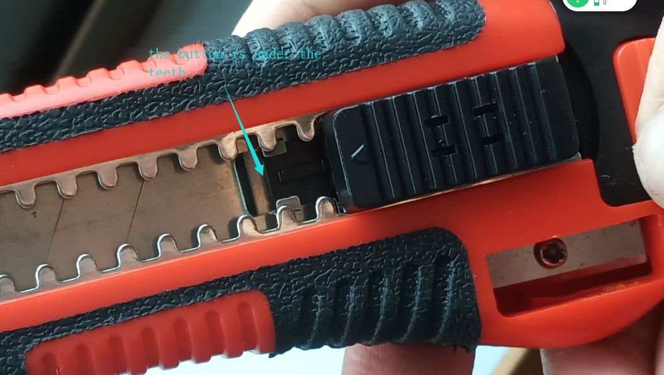
CLAUSS #18727
At first, the sliding button (front part) must be under the teeth bar, then press the rear plug button and pull out the blade carrier; now the blade carrier can be separated from the cutter.
If you want to push the blade carrier back into the cutter body, the sliding button must be fixed in the cutter and stay in the middle of the cutter, then insert the blade carrier into the cutter body.
Please refer to the below images as well:

Slide 2
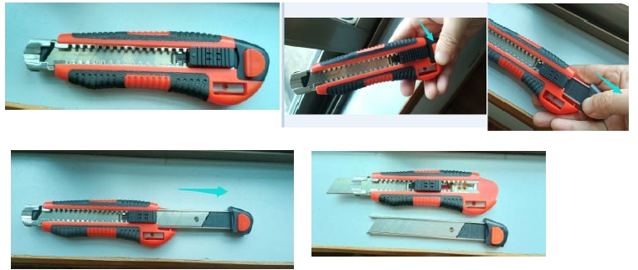
CLAUSS #18727

Slide 3
CLAUSS #18727

